Slide 1
Which edges matter?
Aayush Bansal (CMU), Adarsh Kowdle (Microsoft), Devi Parikh (VT), Andrew Gallagher (Cornell), Larry Zitnick (MSR)

Slide 2

Edge types

Slide 3
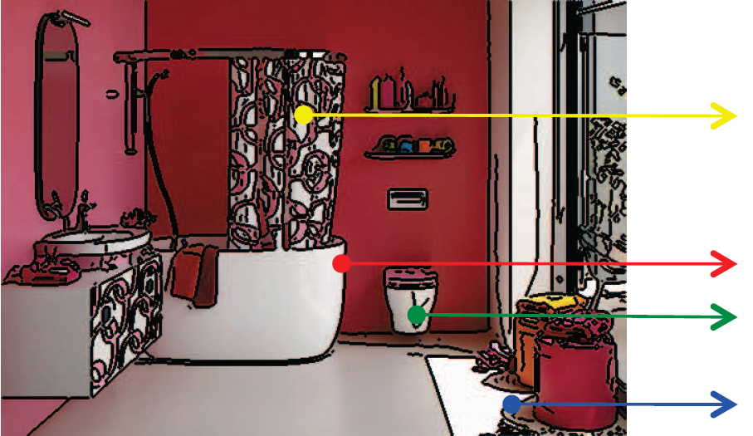
Edge types
Albedo
Depth
Surface normal
Shadow

Slide 4
Which are useful for recognition?

Slide 5
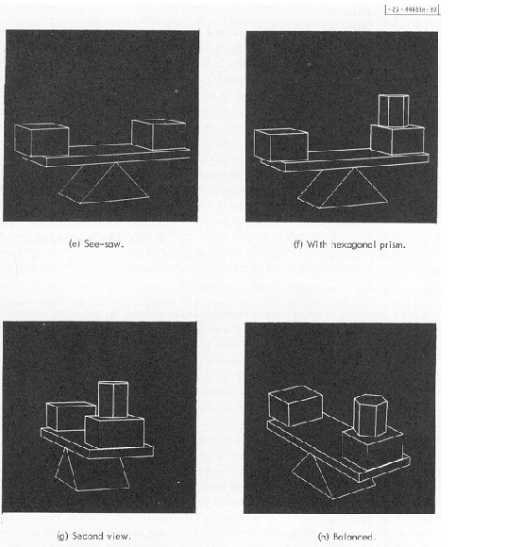
Roberts, 1965

Slide 6
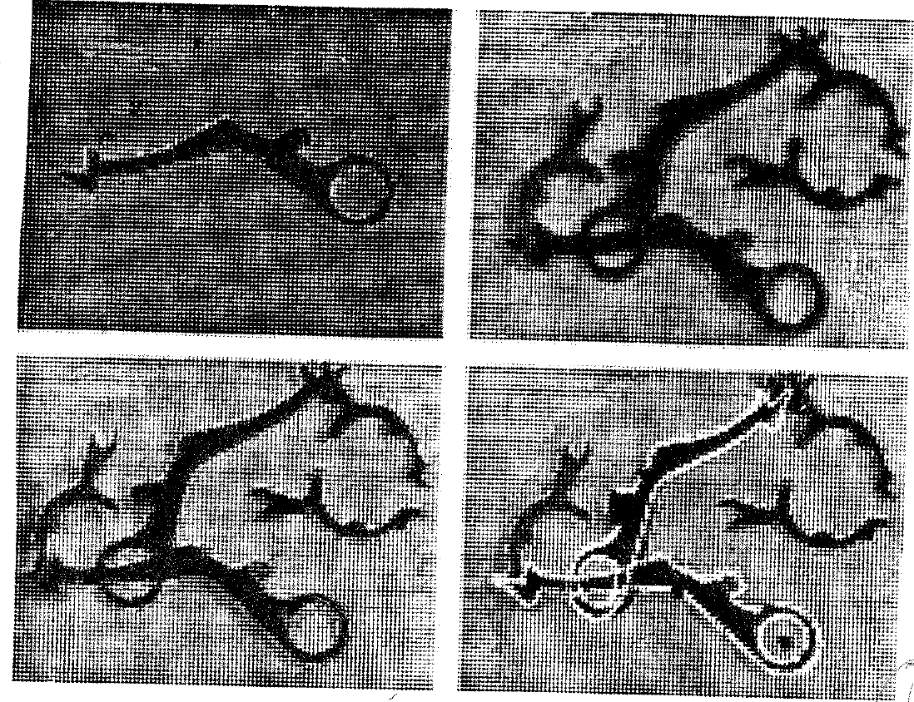
Huttenlocher and Ullman, 1987

Slide 7
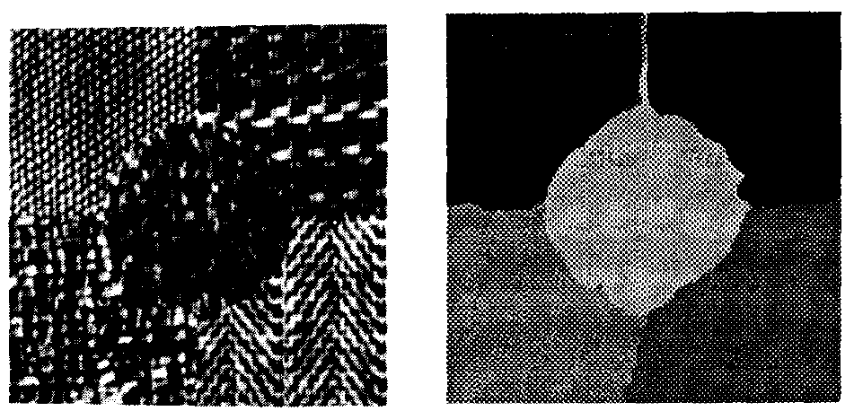
Jain and Farrokhnia, 1990

Slide 8
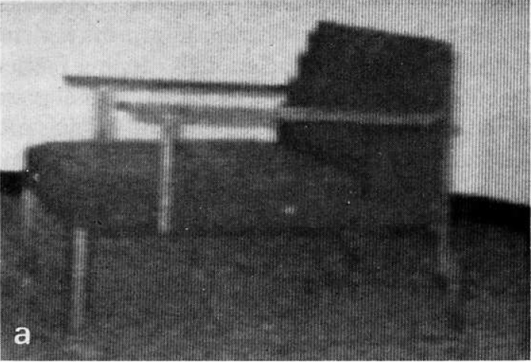

Kanade, 1981

Slide 9


Slide 10

Eitz etal., 2011

Slide 11
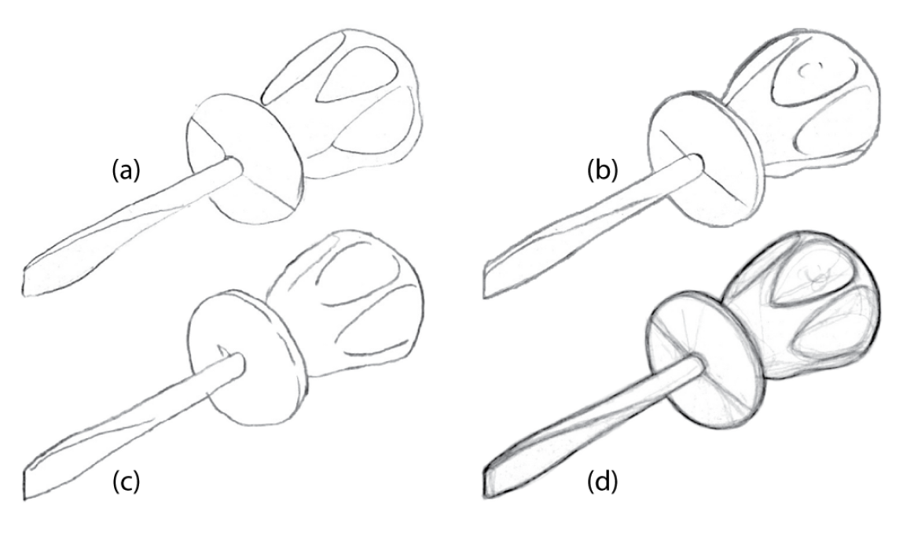
Cole etal., 2008

Slide 12
Can we isolate the effect of different edge types?

Slide 13

Synthetic scenes
46 scenes, Google 3DWarehouse

Slide 14

Synthetic scenes
Black and white

Slide 15

Synthetic scenes
Albedo

Slide 16

Synthetic scenes
Gray surface

Slide 17

Synthetic scenes
Gray shaded

Slide 18

Synthetic scenes
Depth

Slide 19
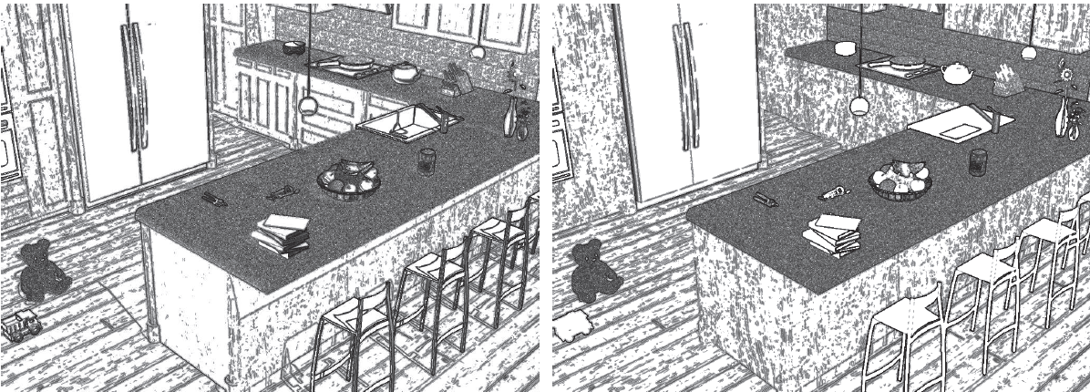

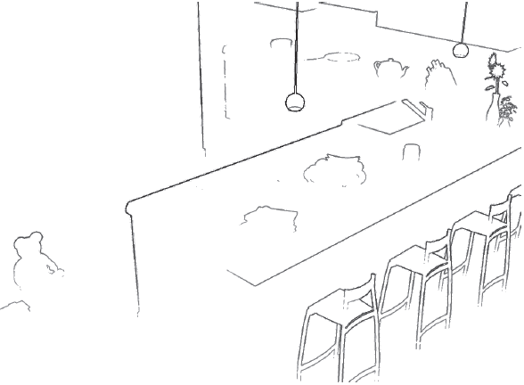
Edges
RGB
Albedo
Gray surface
Gray shaded
Depth

Slide 20
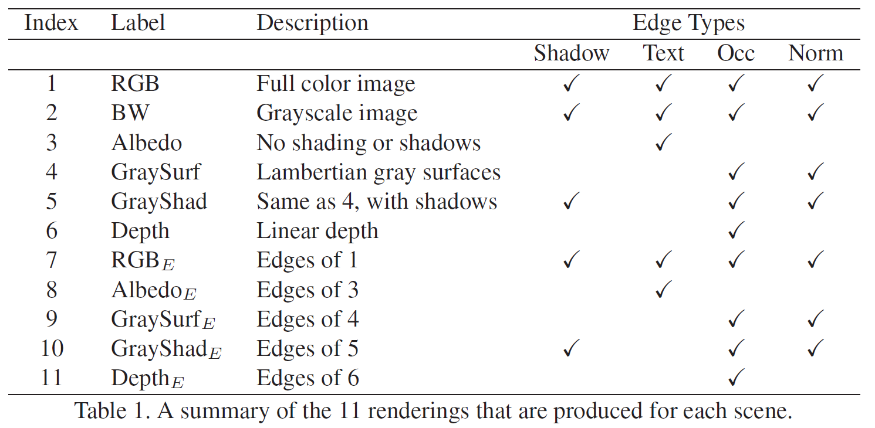

Slide 21

Human studies
265 objects, 11 scene types, 10 subjects per test

Slide 22
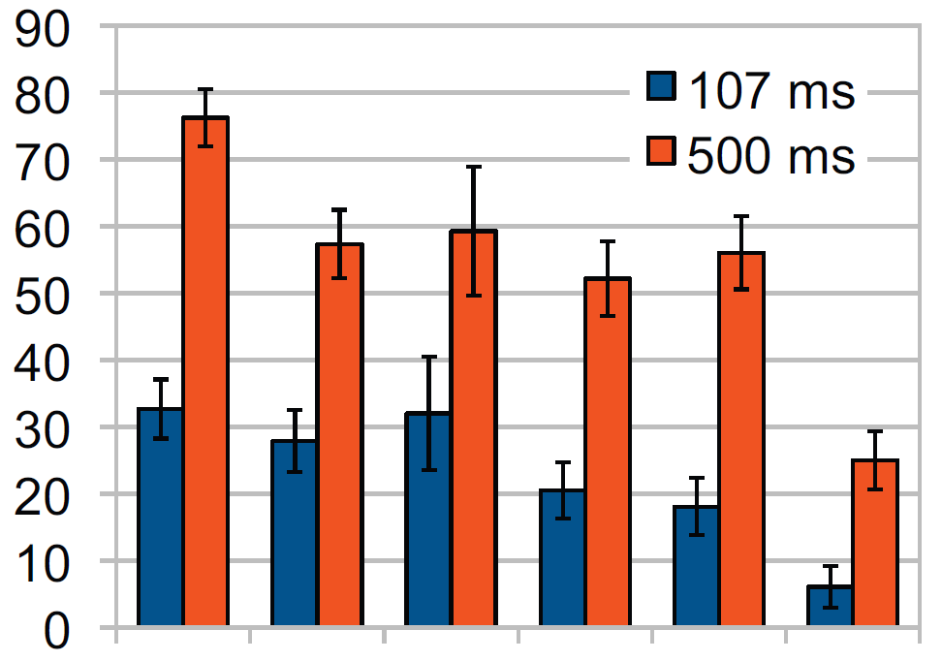
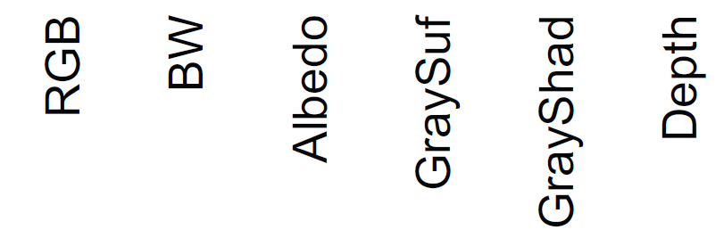
Results

Slide 23
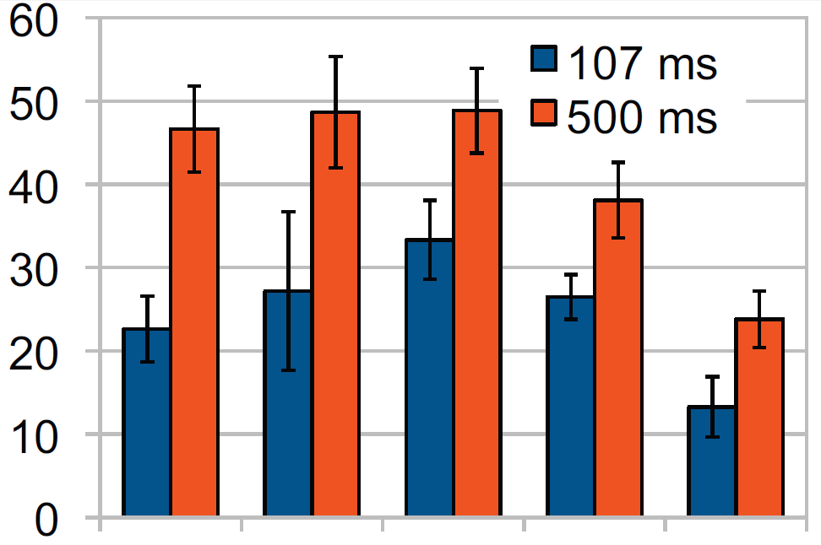
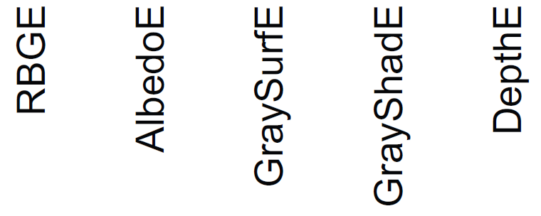
Results

Slide 24
What type of edges do our edge detectors find?

Slide 25


Slide 26
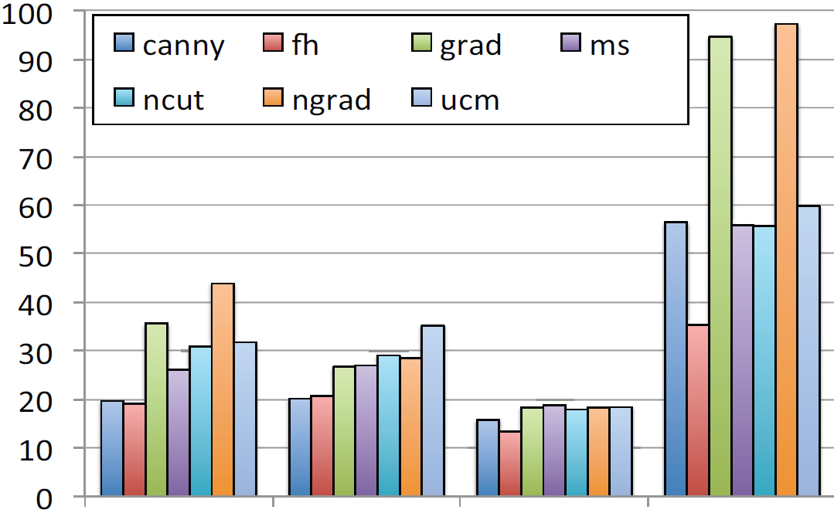
Precision
Depth
Surface normal
Shadow
Texture

Slide 27
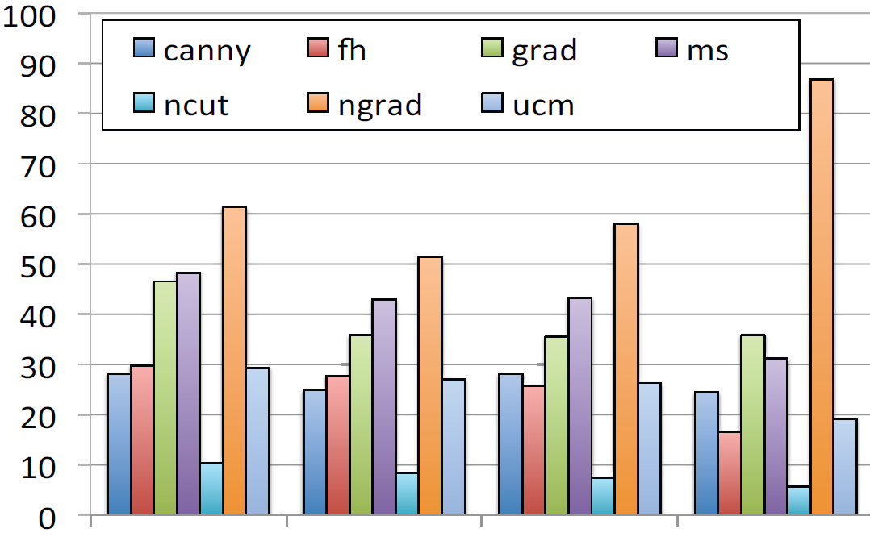
Recall
Depth
Surface normal
Shadow
Texture

Slide 28
Can we further improve our edge detectors?

Slide 29


Contour detection
Parikh and Zitnick, CVPR 2012

Slide 30
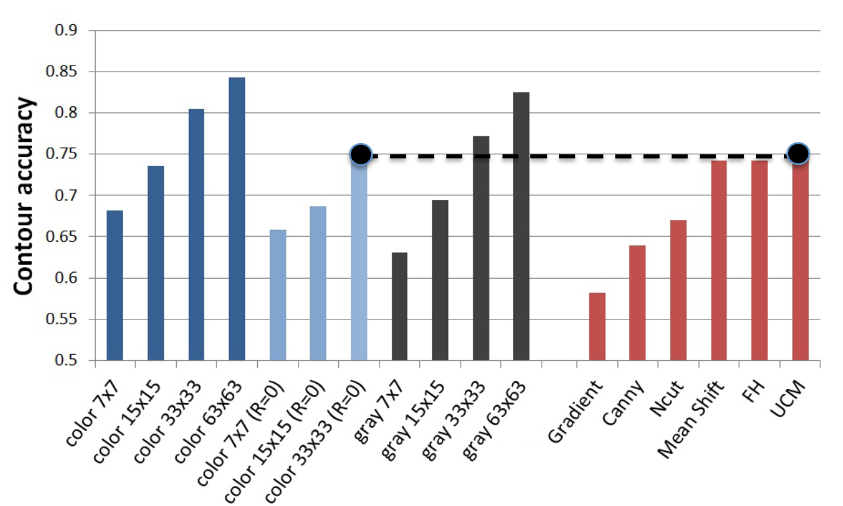

Slide 31
Conclusion
Depth and surface normal edges are most informative for recognition
Most automatic edge detectors find a significant number of albedo and shadow edges
Better methods for evaluating edge detectors?
Are lines important or just edges?

